Slide 1
Comp262 Group 3
Members:
Roland Joseph Baja
Christian Aduna

Slide 2
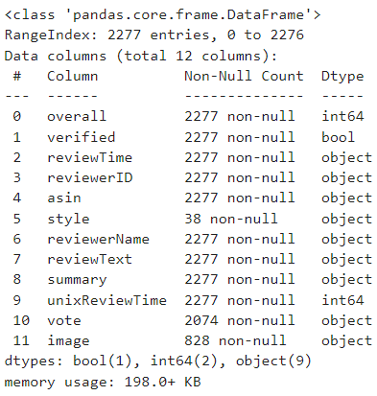
Dataset description
overall - Product Rating(int64)
verified - Product Verified(bool)
reviewTime - Time of the review(object)
reviewerID - ID of the reviewer(object)
asin- ID of the Product also known as Amazon Standard Identification Number(object)
style-style of the product(object)reviewer
Name- The name of the reviewer of the product(object)
reviewText- Review of the product(object)
summary- Summary of the review(object)
unixReviewTime-(int64 )vote - Votes if review is helpful or not (object)
image- Image from the user/reviewer(object)

Slide 3
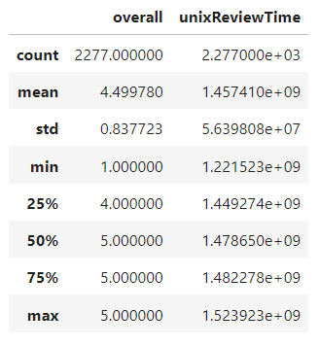
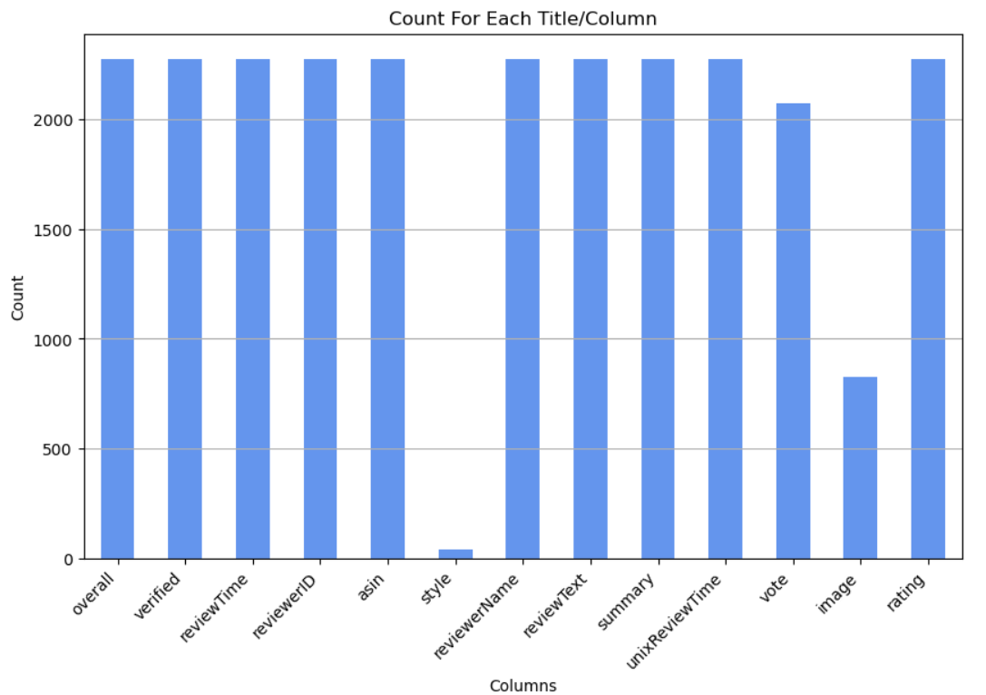
Count for each column

Slide 4
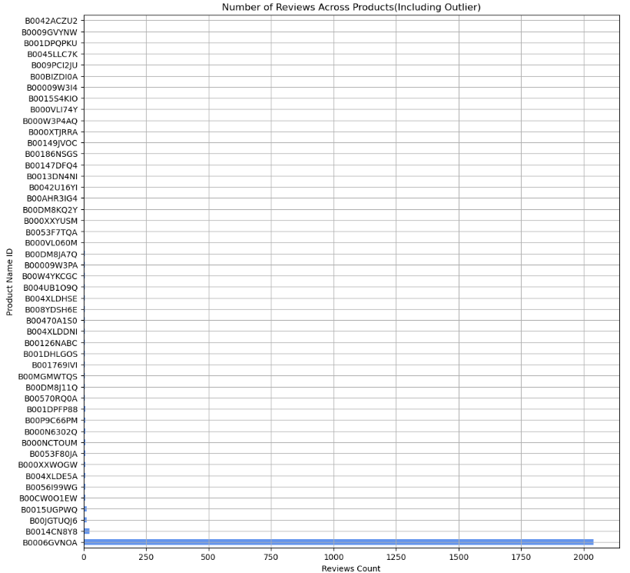
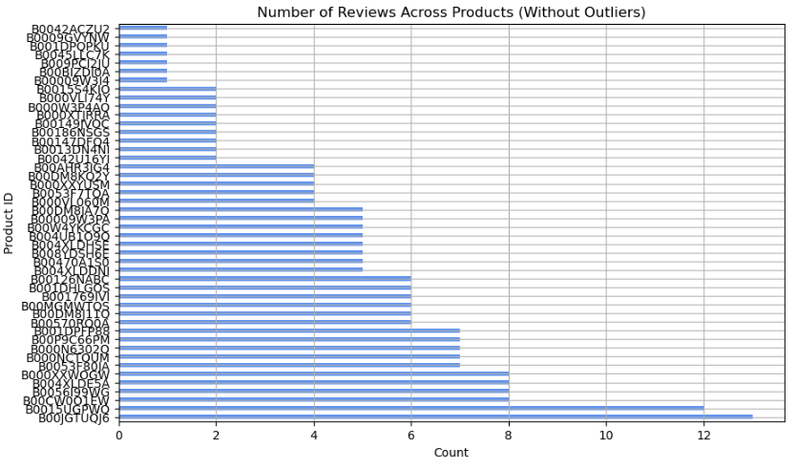
Product ID review(with outlier vs without)

Slide 5
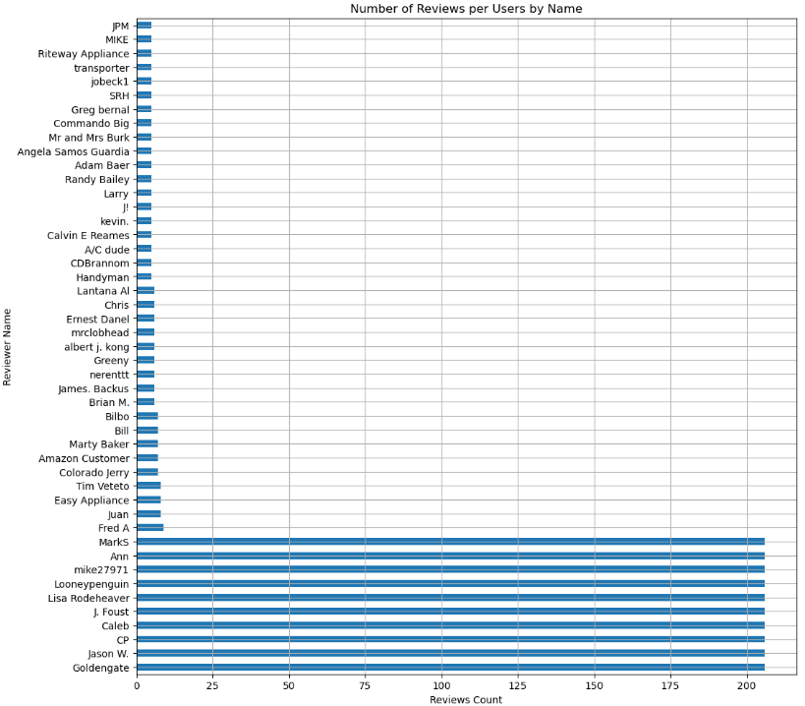
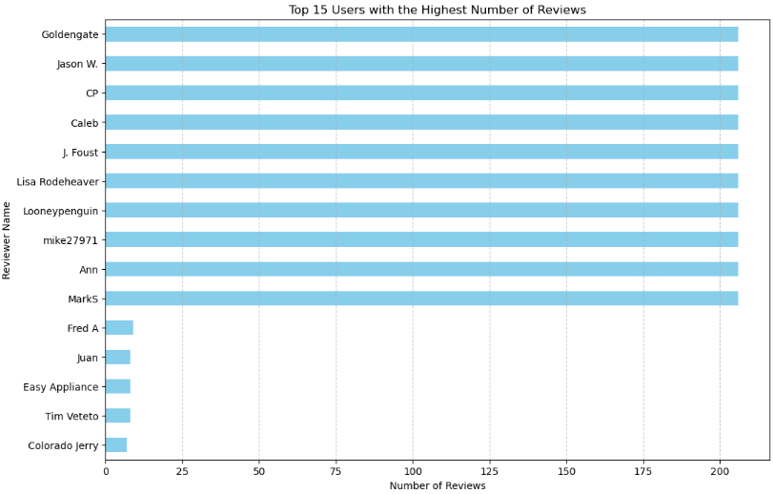
User review count

Slide 6

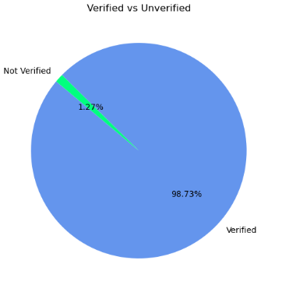
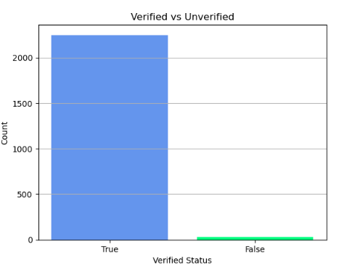
Number of verified products

Slide 7
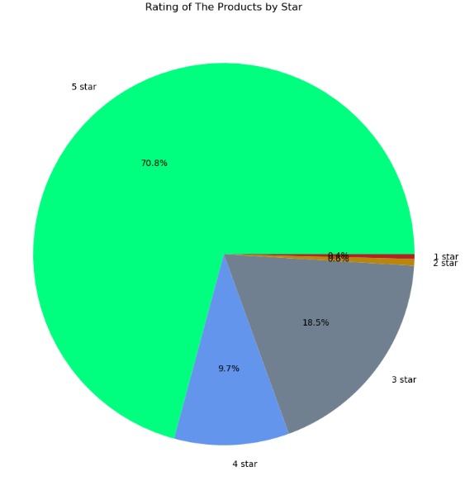
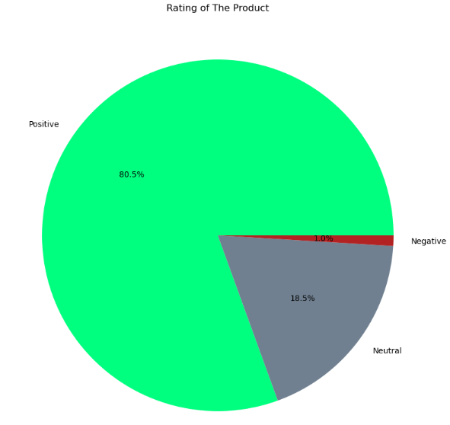
Rating of the product
Rating Breakdown
Positive=1834
Neutral = 421
Negative =22
Overall Breakdown
1 star =9
2 star = 13
3 star =222
4 star =421
5 star =1612

Slide 8
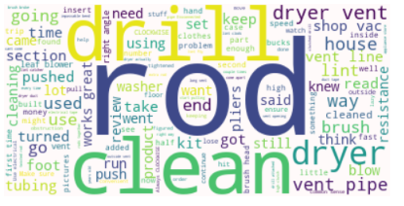
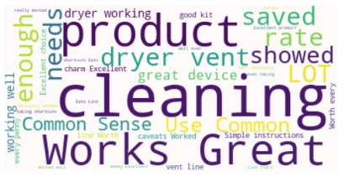
wordcloud
Reviewtext WordCloud
Summary Wordcloud

Slide 9
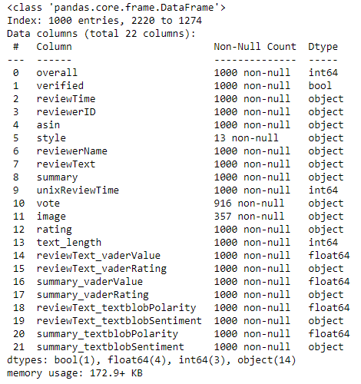
Original vs New Dataframe
Original Dataframe
New Dataframe

Slide 10
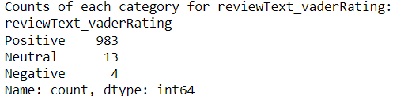
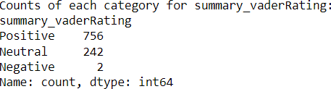
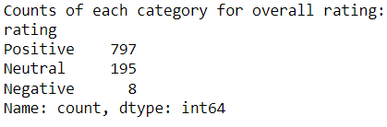
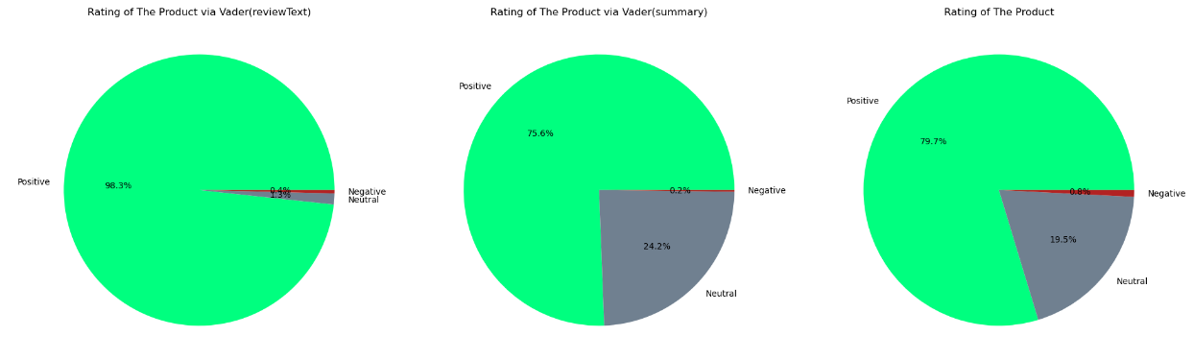
Vader Lexicon

Slide 11
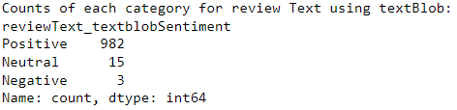
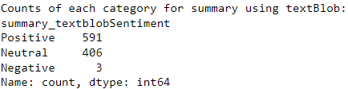
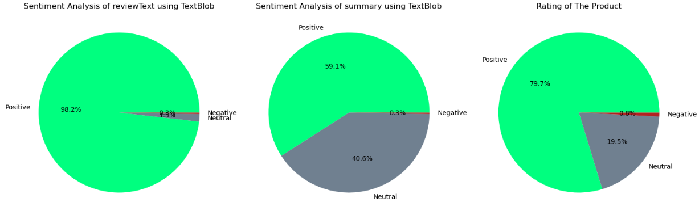
Textblob Lexicon

Slide 12
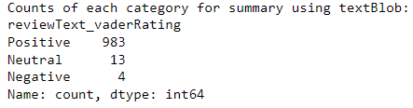
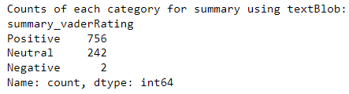
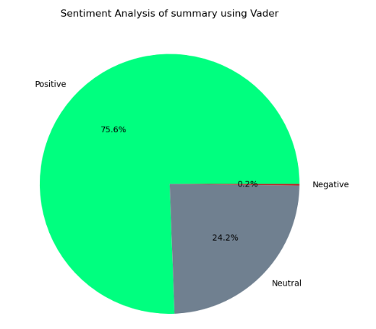
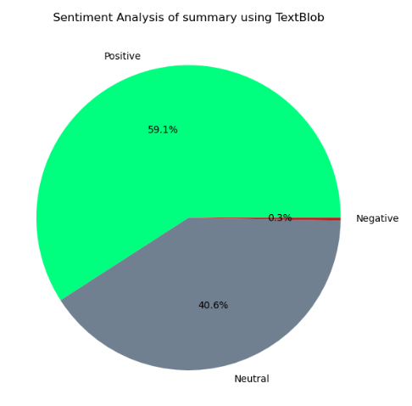
Vader vs TextBlob (Summary DataFrame)

Slide 13
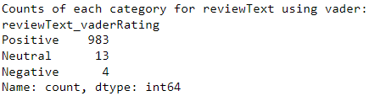
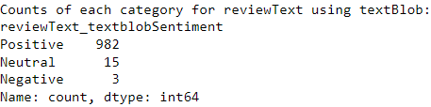
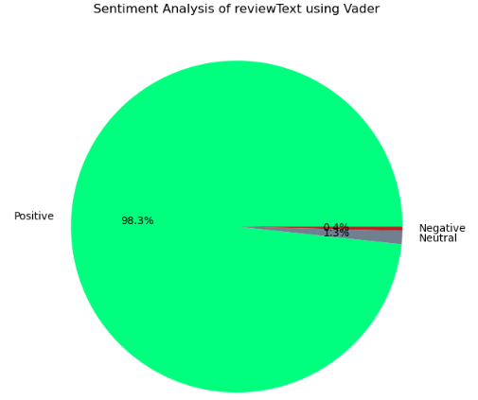
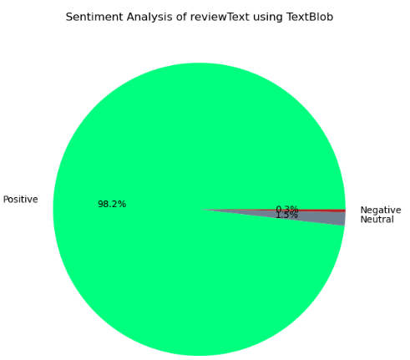
Vader vs TextBlob (Reviewtext DataFrame)

